Slide 1

Tic Tac Toe Game Project
A detailed overview of the development and features of a unique Tic Tac Toe game.

Slide 2
Introduction
This presentation delves into the Tic Tac Toe project developed as part of an internship, highlighting the unique features, technology used, and the implementation of an AI opponent.

Slide 3

01
Project Overview

Slide 4
Introduction to the Tic Tac Toe Game
The Tic Tac Toe game is a classic and widely recognized game that has been revitalized through this project. It allows players to engage in strategic gameplay against either a human or an AI opponent. The project aims to provide an entertaining experience while demonstrating programming skills.

Slide 5
Technology Stack: HTML, CSS, JavaScript
This project employs HTML for the structure of the game interface, CSS for styling enhancements that improve user experience, and JavaScript to implement the game logic and interactivity. Together, these technologies create a seamless and responsive gaming experience.

Slide 6

Project Objectives and Goals
The primary objectives of the Tic Tac Toe project include enhancing programming skills, creating a user-friendly game interface, and implementing an AI opponent that challenges players. The project aims to merge entertainment with education, enabling players to sharpen their strategic thinking while enjoying a classic game.

Slide 7
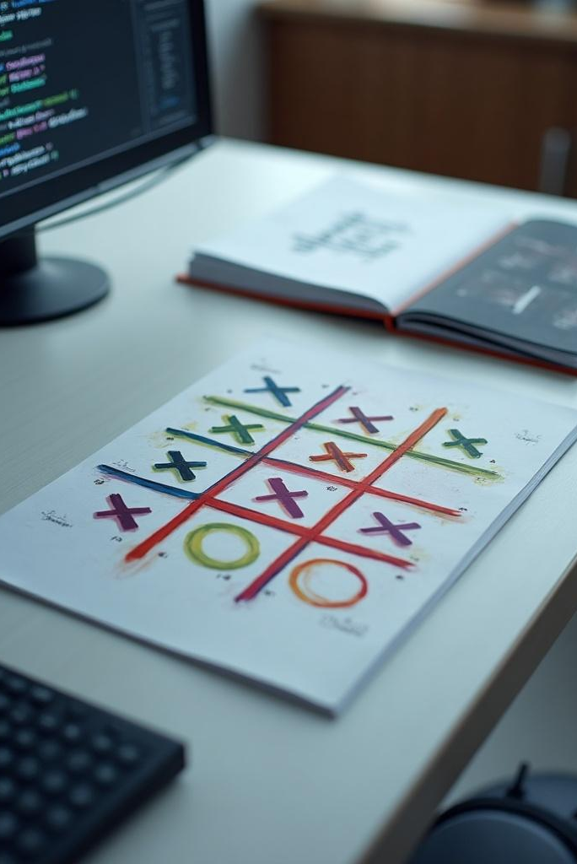
02
Game Features

Slide 8
Unique Aspects of the Game
This Tic Tac Toe game distinguishes itself with interactive elements and visually appealing design. It incorporates features such as score tracking, player statistics, and an option to play against a sophisticated AI opponent, providing varied challenges for players of all skill levels.

Slide 9

AI Opponent Functionality
The AI opponent is programmed to assess potential moves and respond intelligently, providing a competitive gaming experience. Utilizing algorithms, it decides on optimal strategies, ensuring that players face engaging challenges that require thoughtful responses and tactics.

Slide 10
User Interface and Experience Design
The user interface is crafted to be intuitive and accessible, featuring clear navigation and responsive design. The aesthetic appeal is enhanced through CSS, ensuring that players have an enjoyable and immersive gaming experience, whether playing on desktop or mobile devices.

Slide 11
Conclusions
In conclusion, the Tic Tac Toe project showcases not only technical programming skills but also creativity in game design. The implementation of an AI opponent elevates the game experience, making it a dynamic platform for users. The project successfully meets its objectives, contributing to both user enjoyment and skill development.

